Slide 1
Uploading Files to the Remote Server
Using Win_SCP Portable

Slide 2
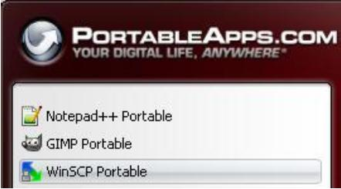
Start Portable Apps.
Select Win_SCP Portable from the Portable Apps Menu options.

Slide 3
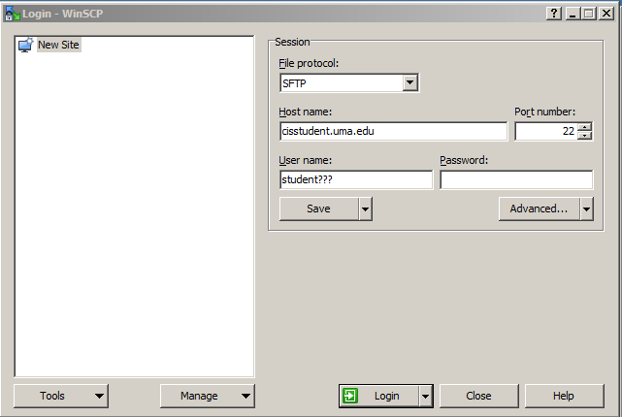
At the Win_SCP Login dialog box, complete the login form as shown at the right:
The UserName is your student number and the Password is the password that you received in an email (which you will change).
The first time you log in, you will be prompted to change the password. You may need to enter the old password three times before typing in your desired password. (Your new password must be at least 8 characters, use upper- and lower-case characters and contain a number and a symbol).
Be sure to change the File protocol: to SFTP
Click the Save… button

Slide 4
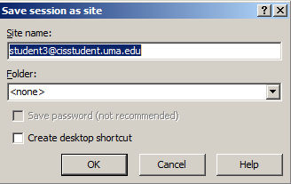
At the Save session as dialog box, you may leave the default session name or type a new one.
Click the OK button.
Your session name now displays as a Stored session, which you may select the next time you want to log into the server.

Slide 5
Click the Login button.
At the Warning message, click the Yes button.
Enter your password (the one that you modified in a previous step)
Momentarily, a new screen will display with two panes (the left is the local computer – the right is the remote server).

Slide 6
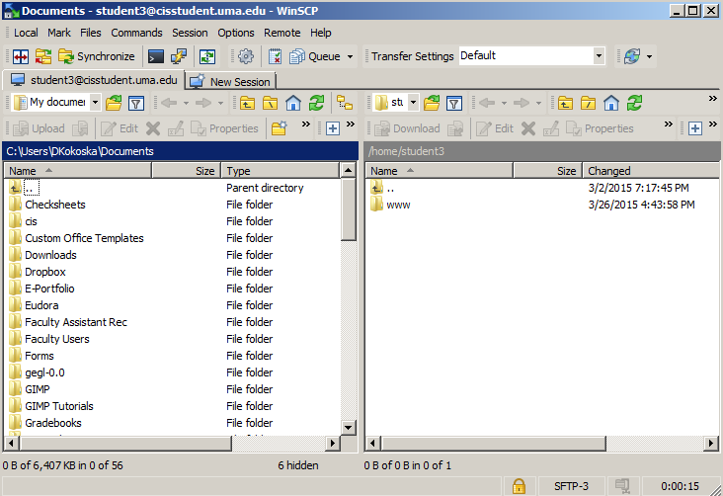

Slide 7
The www folder on the remote server is the default Web folder. In order to display your files in a browser, you will need to put them inside the www folder.
To transfer a folder or a file from the left (local computer) to the right (remote server), you simply drag and drop the files in the folder.
You will drop each of your folders into the www folder.

